Slide 1



System Analysis and Design
CPU Case 02 – Data Flow Diagram, Entity-relationship Diagram, Use case diagram, Use case scenario

Slide 2
Motivation
Systems Analysis and Design
Analysis
Design

Slide 3
Motivation
Systems Analysis and Design
Analysis
Design
System analysis is conducted for the purpose of studying a system or its parts in order to identify its objectives.
It is a problem-solving technique that improves the system and ensures that all the components of the system work efficiently to accomplish their purpose.
Analysis specifies what the system should do.

Slide 4
Motivation
Systems Analysis and Design
Analysis
Design
System Design focuses on how to accomplish the objective of the system.
Convert customer needs into a design that will later be a software system.

Slide 5
Objectives
Understand what are CASE tools
Understand data flow diagrams
Understand entity-relationship diagram
Understand use-case diagrams and use-case scenarios

Slide 6
Content
CASE tools
Context-level Dataflow diagram
Entity-relationship diagram
Use case diagram
Use case scenario

Slide 7
CASE Tools
CASE tools = Computer Aided Software Engineering tools
A domain of software tools used to design and implement applications.
Business and Analysis modeling – Graphical modelling
Development – IDEs
Verification and validation - Analyse code and specifications for correctness.
Project management.

Slide 8
CASE Tools
Examples:
Modelling: Yed Graph Editor, SmartDraw, MS Visio
IDEs: Visual Studio, Netbeans, JetBrains IDEs (PyCharm, IntelliJ IDEA, … )
Testing Tools: TestRail, Xray, Selenium, Kobiton
Project Management: MS Project Management, Trello
Other Integrated tools:
Github
Visible Analyst

Slide 9
Content
CASE tools
Context-level Dataflow diagram
Entity-relationship diagram
Use case diagram
Use case scenario

Slide 10
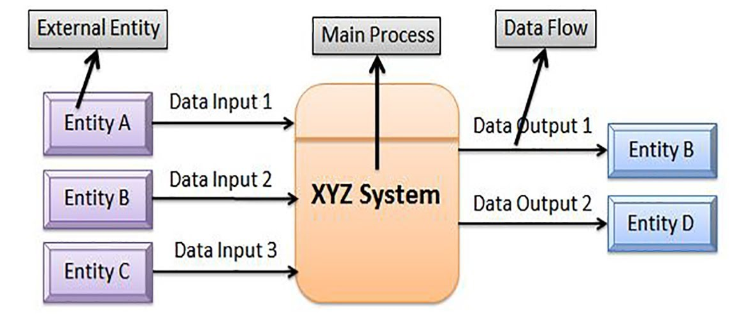
Dataflow Diagram
Data flow diagrams focus on the data flowing into and out of the system and the processing of the data.
The context-level data flow diagram shows the scope of the system, or what is to be included in the system.
Also called Environmental model

Slide 11
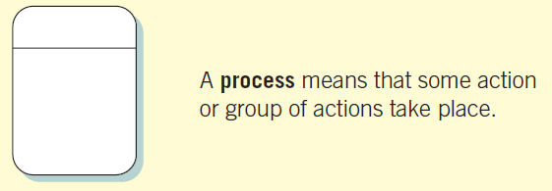
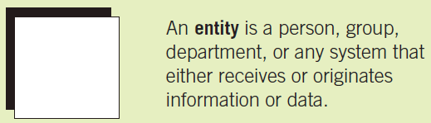
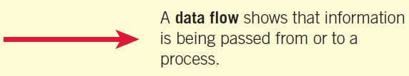
Dataflow Diagram
Basic Symbols

Slide 12
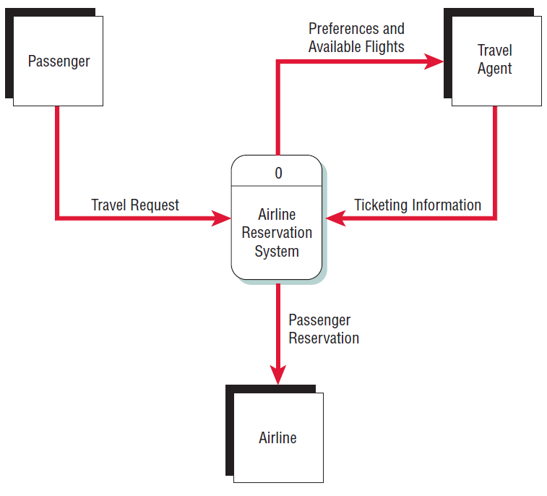
Dataflow Diagram
Example: Airline reservation system.
Entities: Passenger, Travel Agent, Airline
Process: Reservation system

Slide 13
Content
CASE tools
Context-level Dataflow diagram
Entity-relationship diagram
Use case diagram
Use case scenario

Slide 14
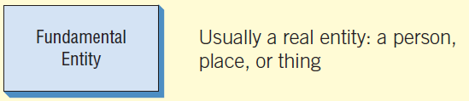
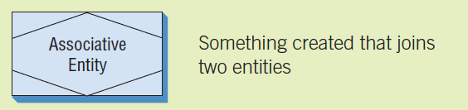
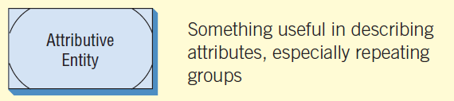
Entity-Relationship Diagram
ER diagram shows the scope of the system and define proper system boundaries.
Types of Entities:

Slide 15
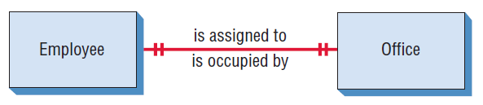
Entity-Relationship Diagram
Types of relationships:
One-to-One

Slide 16
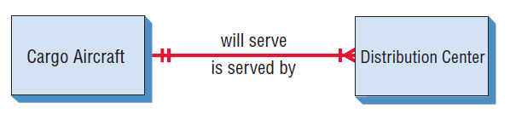
Entity-Relationship Diagram
Types of relationships:
One-to-1…Many

Slide 17
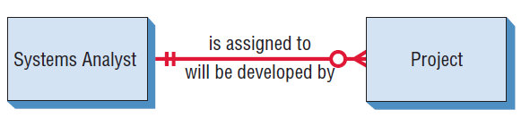
Entity-Relationship Diagram
Types of relationships:
One-to-0 … Many

Slide 18
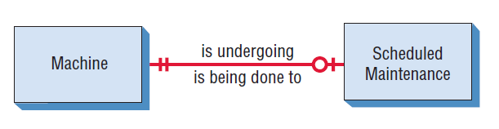
Entity-Relationship Diagram
Types of relationships:
One-to-0 … 1

Slide 19
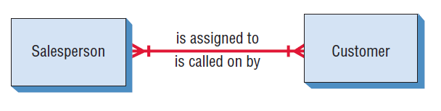
Entity-Relationship Diagram
Types of relationships:
one … many-to-one … many

Slide 20
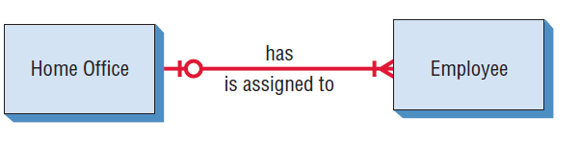
Entity-Relationship Diagram
Types of relationships:
0 … one-to-one … many

Slide 21
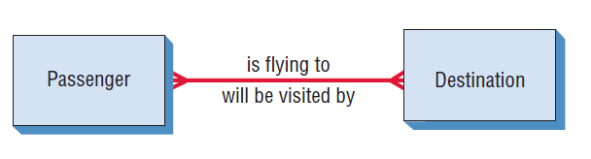
Entity-Relationship Diagram
Types of relationships:
Many-to-many

Slide 22
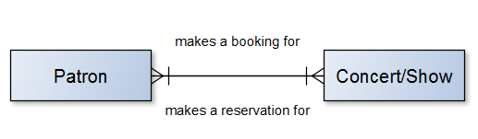
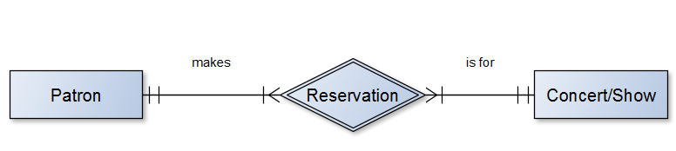
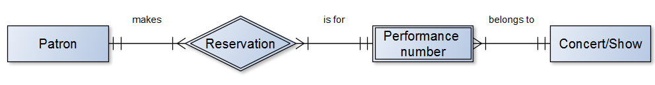
Entity-Relationship Diagram
Example

Slide 23
Content
CASE tools
Context-level Dataflow diagram
Entity-relationship diagram
Use case diagram
Use case scenario

Slide 24
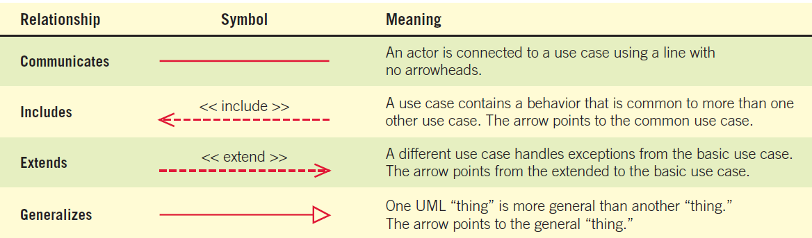
Use Case Diagram
Describes what a system does without describing how the system does it.
Reflects the view of the system from the perspective of a user outside of the system (i.e., the system requirements).
Relationships

Slide 25
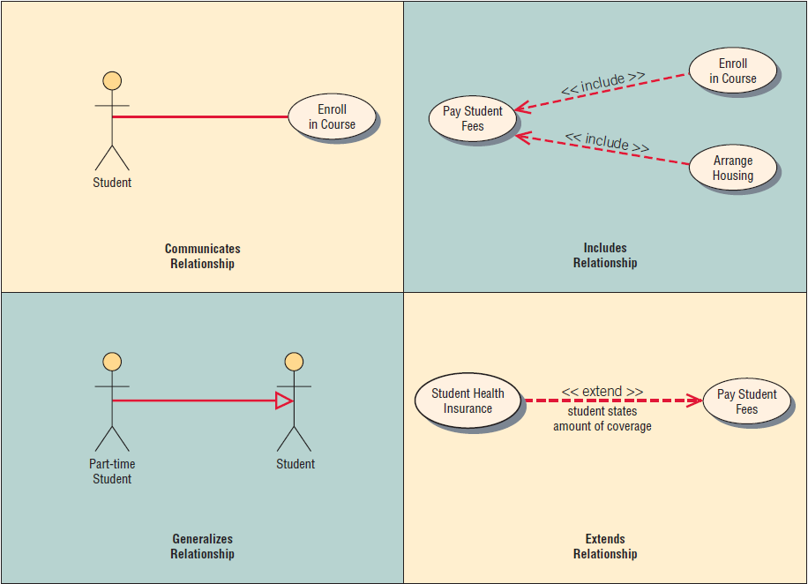
Use Case Diagram
Example

Slide 26
Content
CASE tools
Context-level Dataflow diagram
Entity-relationship diagram
Use case diagram
Use case scenario

Slide 27
Use Case Scenario
Use case scenario is the description of the use case.
A use case scenario is divided into three sections:
identification and initiation;
steps performed;
and conditions, assumptions, and questions.
Example: A use case diagram representing a system used to plan a conference. [open doc file]

